Slide 1
Exploring Network Security with Python and Nmap
By: Nicholas Fisher

Slide 2
Objectives
Learn about Network Reconnaissance:
Understand the importance of gathering information about a target network and how it aids in identifying vulnerabilities.
Introduction to Ethical Hacking:
Explore the concept of ethical hacking and how it differs from malicious hacking.
Python and Nmap:
Gain insights into Python packages and tools like Nmap used in ethical hacking practices.

Slide 3
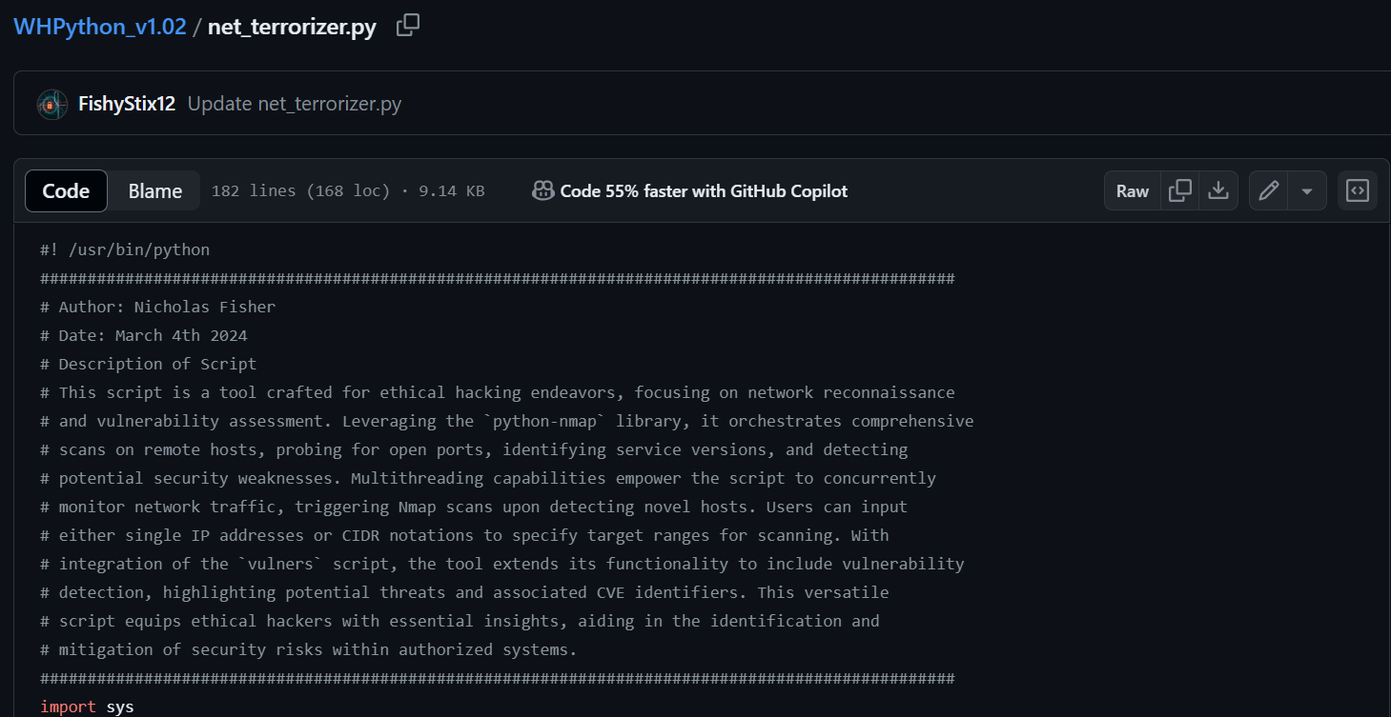
Link to our Course GitHub
Github : https://github.com/FishyStix12/BH.py-CharCyCon2024/tree/main

Slide 4

What is Network Reconnaissance?
Definition:
Network reconnaissance involves actively gathering information about a target network to understand its structure, services, and potential vulnerabilities.
Importance:
It allows security professionals to assess the security posture of a network and identify potential entry points for attackers.
Techniques:
Network reconnaissance techniques include port scanning, banner grabbing, packet sniffing, and vulnerability scanning.

Slide 5

Introduction to Nmap
Overview:
Nmap, short for Network Mapper, is a widely-used open-source tool for network exploration and security auditing.
Features:
Nmap offers features such as port scanning, service version detection, OS detection, and scripting capabilities, making it a versatile tool for network analysis.
Applications:
It is used by network administrators, security professionals, and ethical hackers for network troubleshooting, vulnerability assessment, and penetration testing.

Slide 6

Understanding the Python Nmap Script net_terrorizer.py
Description of this Script:
The provided script is a tool designed for ethical hacking purposes, focusing on network reconnaissance and vulnerability assessment. It leverages the python-nmap library and other Python packages to automate comprehensive scans on remote hosts.

Slide 7
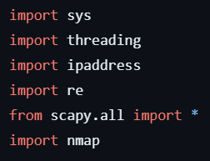
Python Packages Used v
nmap: A Python package providing an interface to Nmap, enabling users to automate network scanning and analysis tasks.
scapy: A powerful Python library for packet manipulation, sniffing, and network scanning, offering flexibility and control over network interactions.
ipaddress: This Python module facilitates the handling of IP addresses and networks, simplifying tasks such as IP address validation, manipulation, and subnetting.
threading: Python's built-in module for implementing multithreading, allowing concurrent execution of tasks and enhancing performance in network-intensive applications.
re: The re module provides support for regular expressions in Python, enabling pattern matching and text parsing, which is useful for processing network data.
How to import the necessary libraries in Linux:
pip install python-nmap
pip install scapy

Slide 8
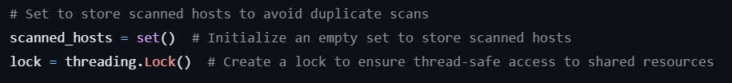
Variables and Callback functions
Variables:
Scanned_hosts:
A set data structure to store the IP addresses of hosts that have been scanned, preventing duplicate scans.
lock:
A threading lock object used to ensure thread-safe access to the scanned_hosts set, preventing data corruption in concurrent execution scenarios.

Slide 9
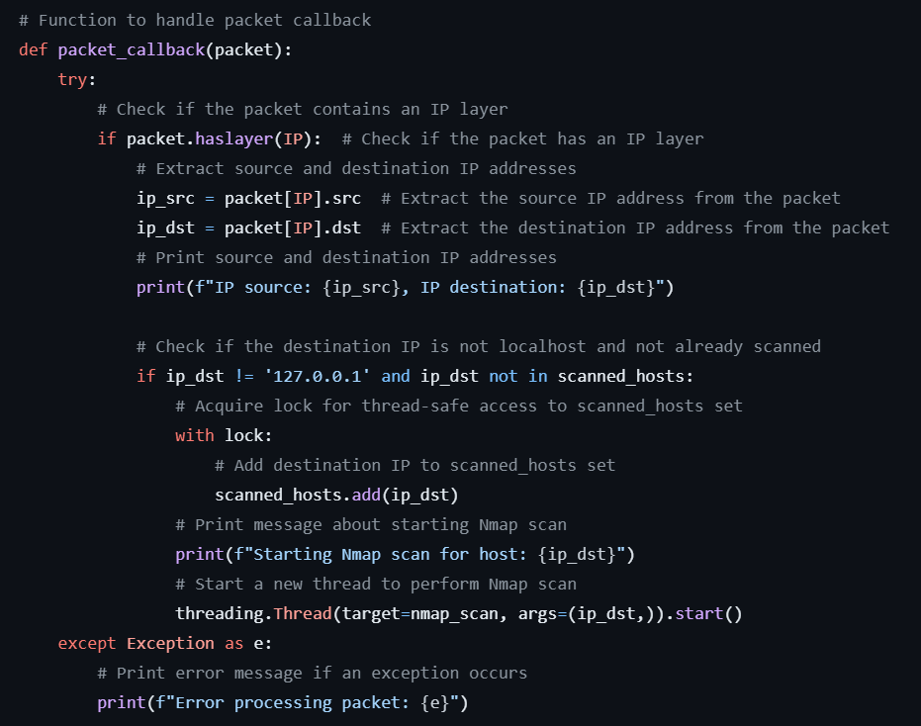
Packet Callback Function
Purpose:
The packet callback function (packet_callback(packet)) is responsible for handling packet sniffing using the Scapy library.
Functionality:
Extracts source and destination IP addresses from incoming packets.
Checks if the destination IP address is not localhost and has not been previously scanned.
Initiates an Nmap scan for new hosts in separate threads to avoid blocking packet processing.

Slide 10
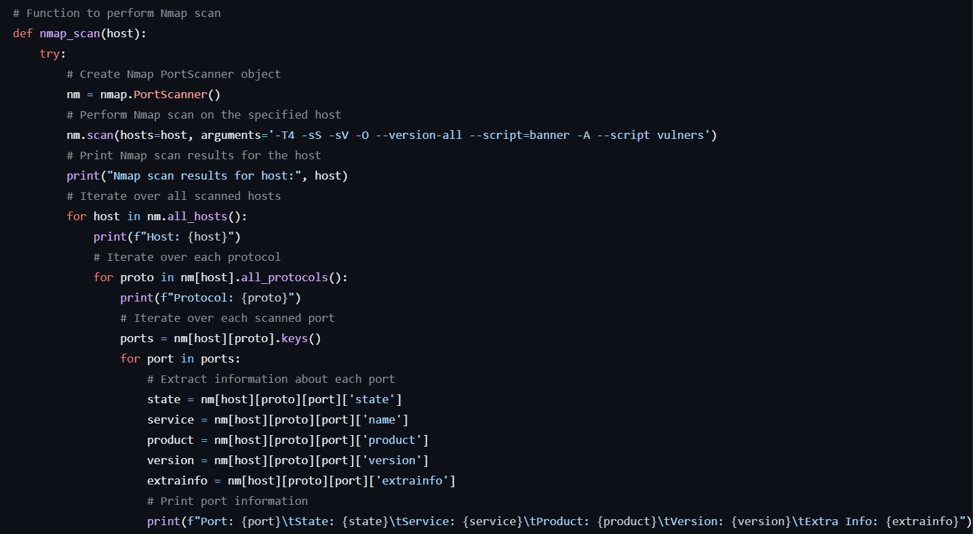
Nmap Scan Function Part 1
Purpose:
The nmap_scan(host) function performs Nmap scans on specified hosts, extracting information about open ports, service versions, OS detection, and vulnerabilities.

Slide 11
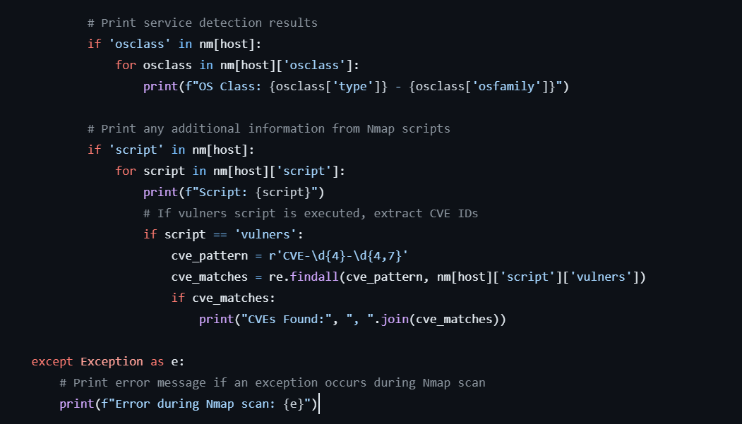
Nmap Scan Function Part 2
Functionality:
Utilizes the nmap.PortScanner() class to create an Nmap scanner object.
Executes Nmap scans on the specified host using custom scan arguments.
Processes scan results to extract information about scanned hosts, open ports, services, OS detection, and vulnerability assessments.

Slide 12
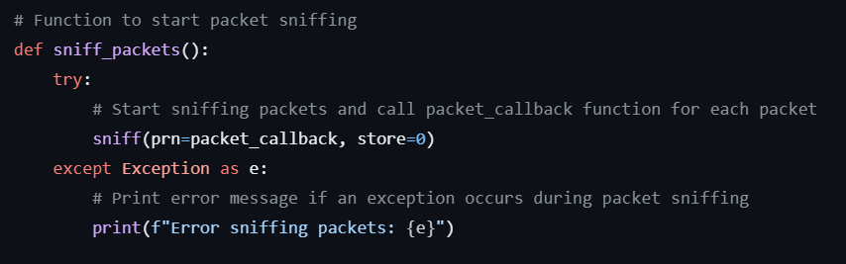
Packet Sniffing Function
Purpose:
The sniff_packets() function initiates packet sniffing using the Scapy library, calling the packet callback function (packet_callback(packet)) for each received packet.
Functionality:
Starts packet sniffing using the sniff() function from the Scapy library.
Calls the packet callback function (packet_callback(packet)) for each captured packet.
Enables real-time monitoring of network traffic to detect new hosts and trigger Nmap scans.

Slide 13
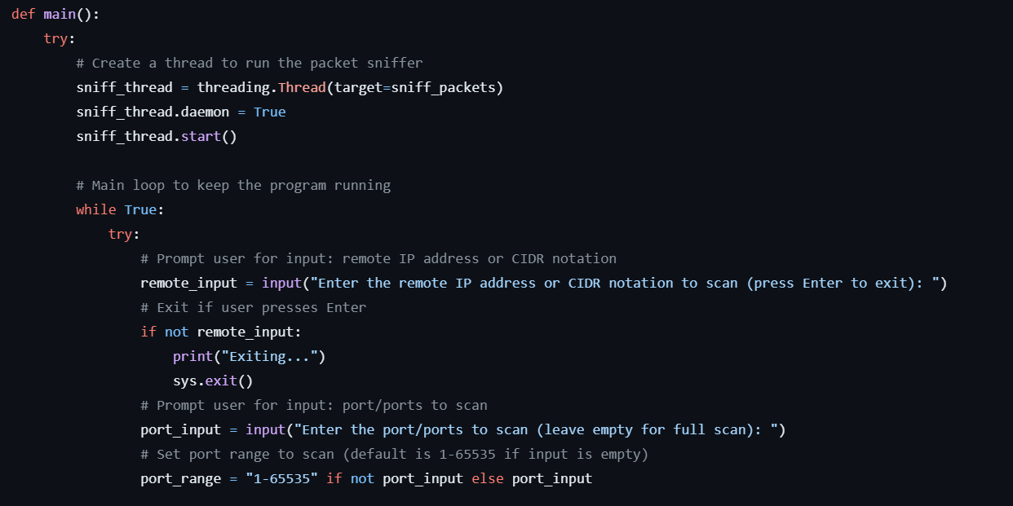
Main Function
Purpose:
The main() function serves as the entry point of the script, orchestrating user interaction, input handling, and thread management for continuous scanning.
Functionality:
Creates a separate thread to handle packet sniffing (sniff_packets() function).
Prompts the user for input: remote IP address or CIDR notation to initiate Nmap scans.
Handles user input validation and error handling.
Initiates Nmap scans for specified hosts or IP address ranges, ensuring concurrency with multithreading.

Slide 14
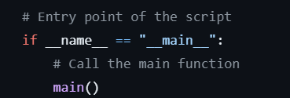
Entry Point of the Script
Purpose:
The if __name__ == "__main__": block serves as the entry point of the script.
Functionality:
It ensures that the main() function is called when the script is executed as the main program.
This conditional statement is a common Python idiom that checks whether the script is being run directly or imported as a module.
When the script is executed as the main program, the main() function is called to initiate the script's functionality.

Slide 15
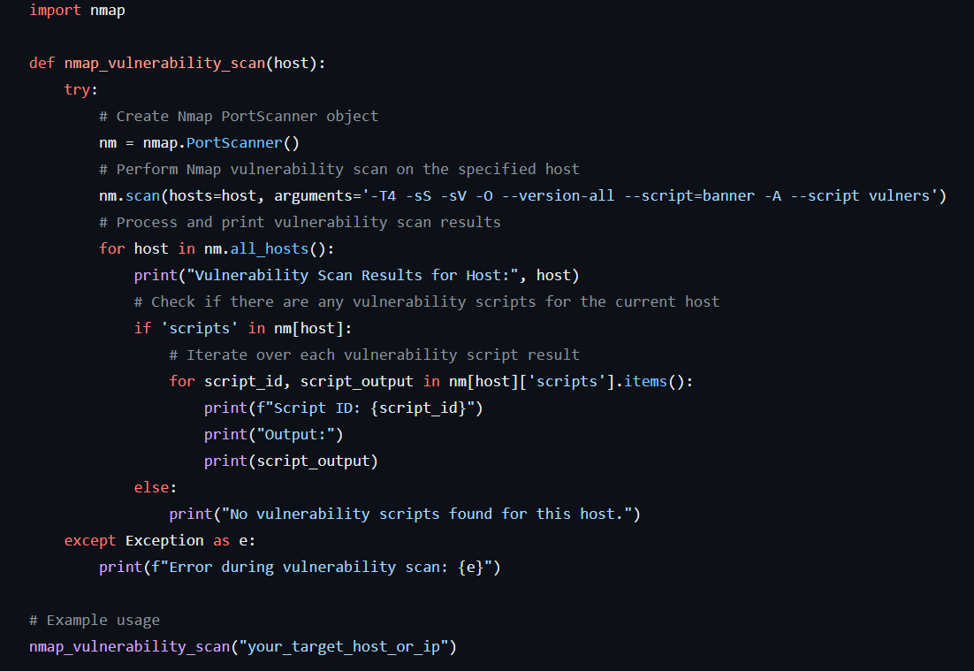
Building Your Own Script : Step 1: Define Necessary Functions
Nmap Vulnerability Scan Function:
Design a function to perform Nmap vulnerability scans on specified hosts. This function will utilize the nmap module to execute scans and extract vulnerability information. Example is provided in the image to the right.
Parameters:
Host(s) to scan, scan options (if any).
Implementation:
Use the nmap.PortScanner() class to create an Nmap scanner object. Then, invoke the scan() method with appropriate arguments to conduct vulnerability scans. Extract and process vulnerability data from the scan results.

Slide 16
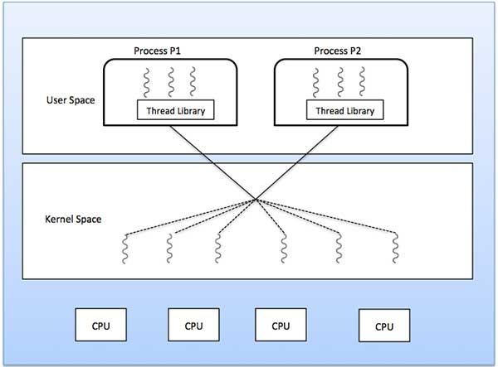
Building Your Own Script : Step 2: Implement Multithreading
Concurrent Scan Execution:
Enhance the script with multithreading capabilities to execute vulnerability scans concurrently on multiple hosts.
Use Python's threading module to create and manage multiple threads, each responsible for scanning a separate host.
Ensure thread safety when accessing shared resources, such as scan results or output printing.

Slide 17

Building Your Own Script : Step 3: Enhance Functionality
Input Validation and Error Handling:
Implement robust input validation to ensure that only valid IP addresses or hostnames are accepted as input for vulnerability scans. Handle errors gracefully and provide informative error messages to users.
Scan Options and Customization:
Offer options for users to specify additional Nmap scan arguments or customize the scan behavior according to their requirements. This can include options for timing, output formatting, or scan intensity.

Slide 18

Questions?

Slide 19

Conclusion
Key Takeaways:
Nmap Vulnerability Scans offer comprehensive network security insights.
Proactive vulnerability assessment aids in identifying and mitigating risks.
Continuous learning and vigilance are crucial for effective cybersecurity measures.
Thank you!

